Slide 1

CSE3151
Computer Networks
(Session 2018-19)
Dr. Asif Zaman
Associate Professor, CSE, RU
May 2022

Slide 2

Text Books
Lesson Plan
Text book
Resources
Slides
Lab materials
https://sites.google.com/site/asifzaman3180/lecture-slides

Slide 3
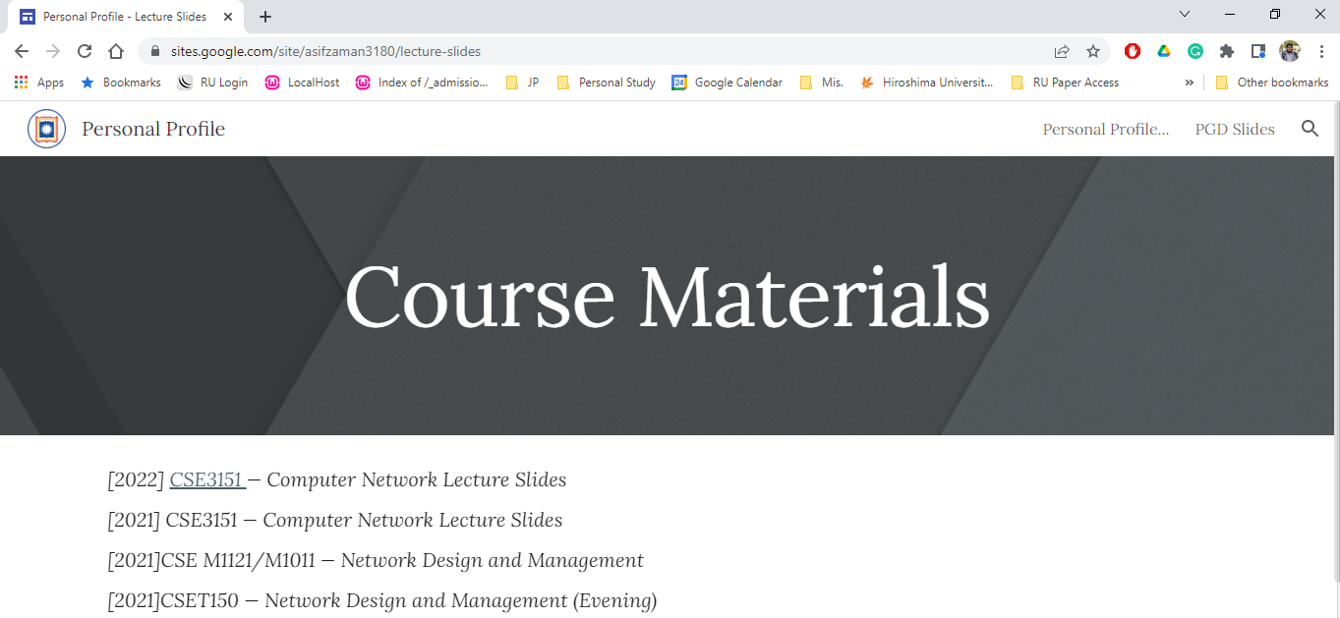

Slide 4
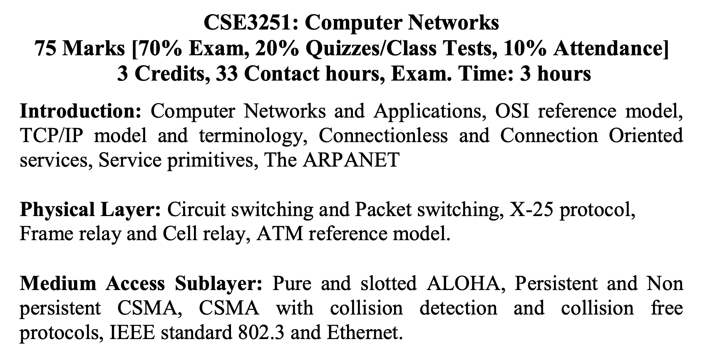
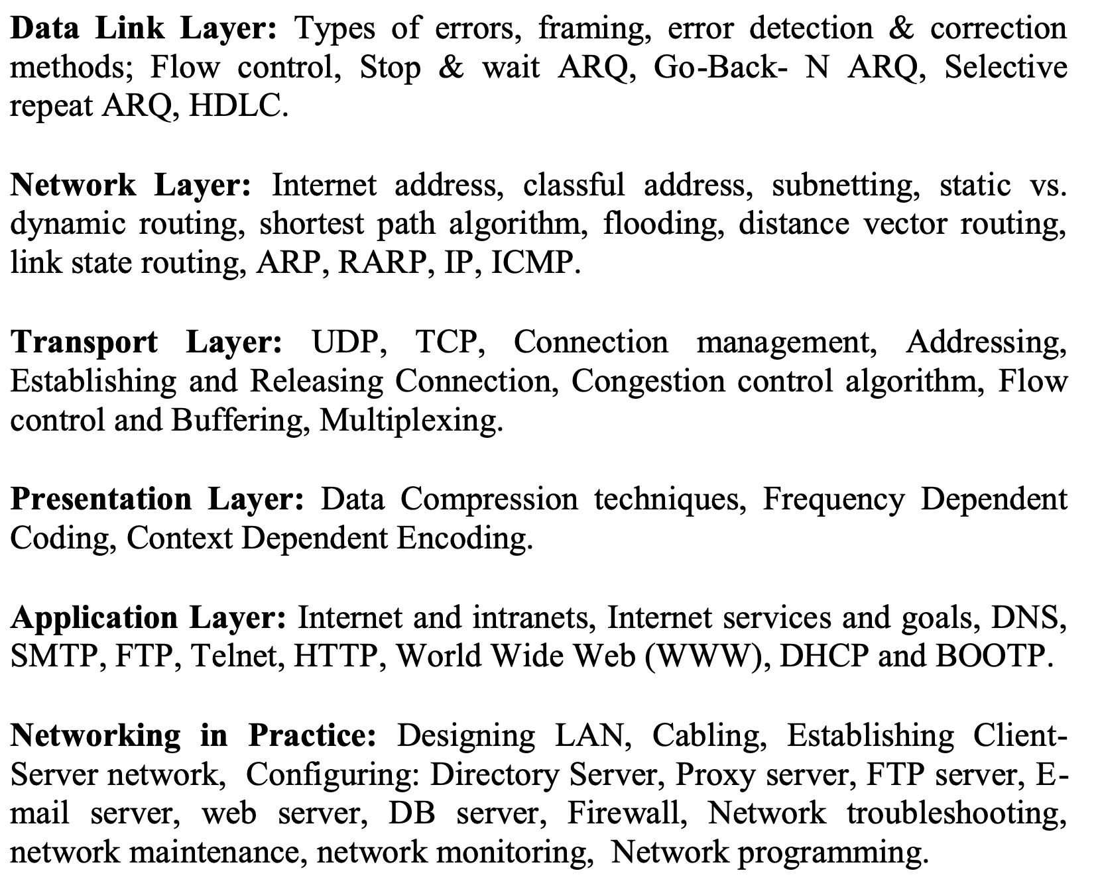

Slide 5
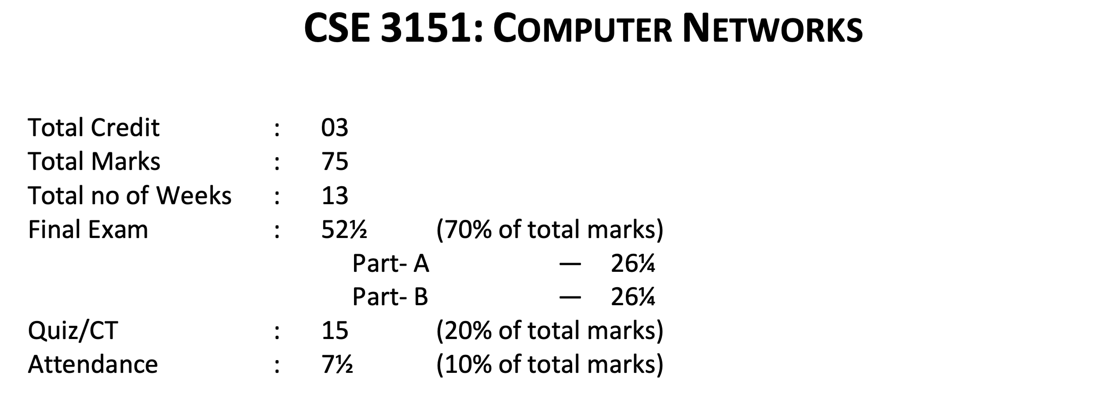
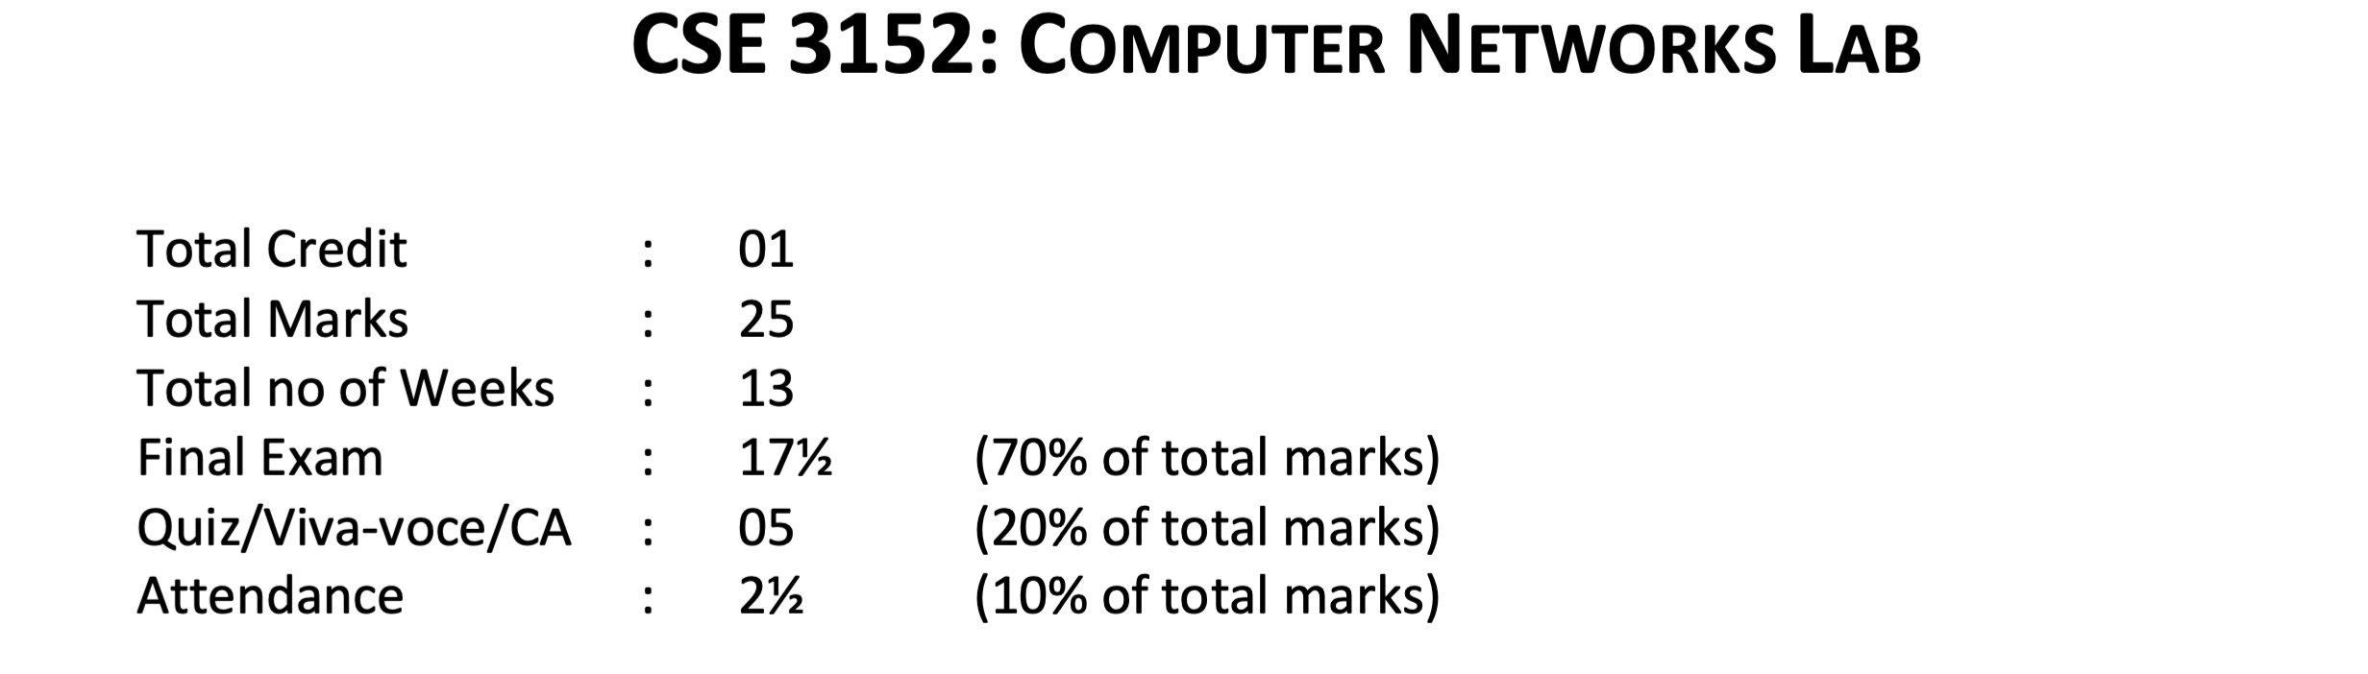

Slide 6
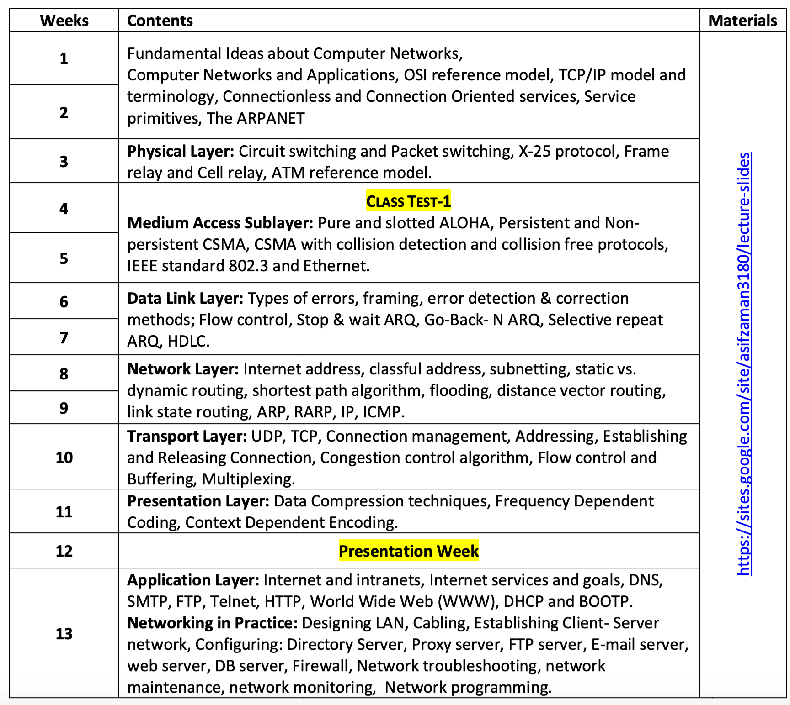

Slide 7
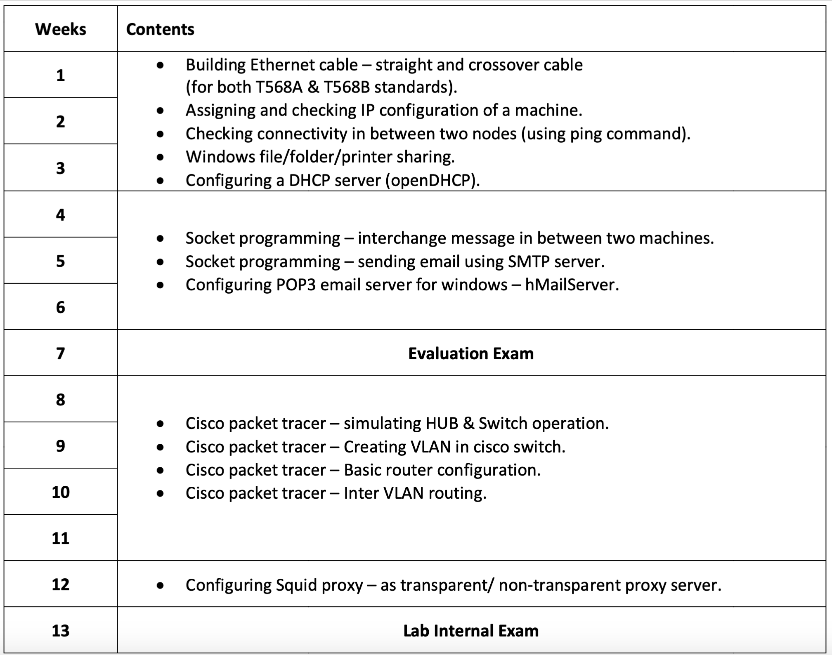

Slide 8
Fundamental Idea
Network Card (LAN Card)
Network Card (LAN Card)

Slide 9
Fundamental Idea
HUB/ SWITCH
Protocol

Slide 10
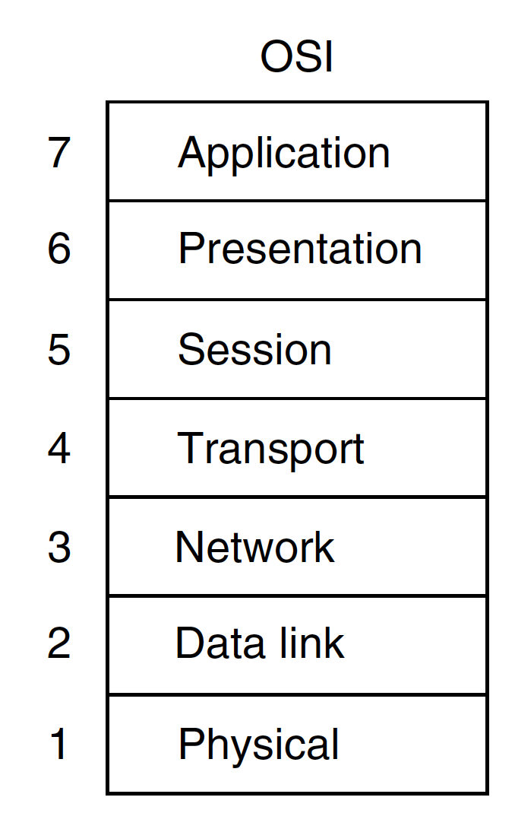
Introduction
All People Seem To Need Data Processing
Open Systems Interconnection
International Organization for Standardization(ISO)

Slide 11
RJ-45 Connector
UTP –Unshielded Twisted Pair

Slide 12
Lab Work

